Slide 1



Git & GitHub
Workshop

Slide 2



Git & GitHub
Workshop
SavanSutariya
savansutariya.hashnode.dev

Slide 4



Yeh hai aam zindagi
Notes:
Joke(Free contributions)

Slide 5
Yeh hai aam zindagi

Slide 6
Yeh hai Mentos zindagi
Notes:
Notice(there is git inside of github)

Slide 7
Git
Basic Configurations

Slide 8
Basic Configurations
Savan@Savan MINGW64 /c/Drive/TermWork/Website
$ git config --global user.name “Your Name”
Savan@Savan MINGW64 /c/Drive/TermWork/Website
$ git config --global user.email “youremail@domain.com”
Git Bash

Slide 9
Basic Configurations
Savan@Savan MINGW64 /c/Drive/TermWork/Website
$ git config --global user.name “Your Name”
Savan@Savan MINGW64 /c/Drive/TermWork/Website
$ git config --global user.email “youremail@domain.com”
Savan@Savan MINGW64 /c/Drive/TermWork/Website
$ git config --global –list
user.email=savanpatel5248@gmail.com
user.name=Savan Sutariya
Git Bash

Slide 10
Git
How to save a Change?

Slide 11
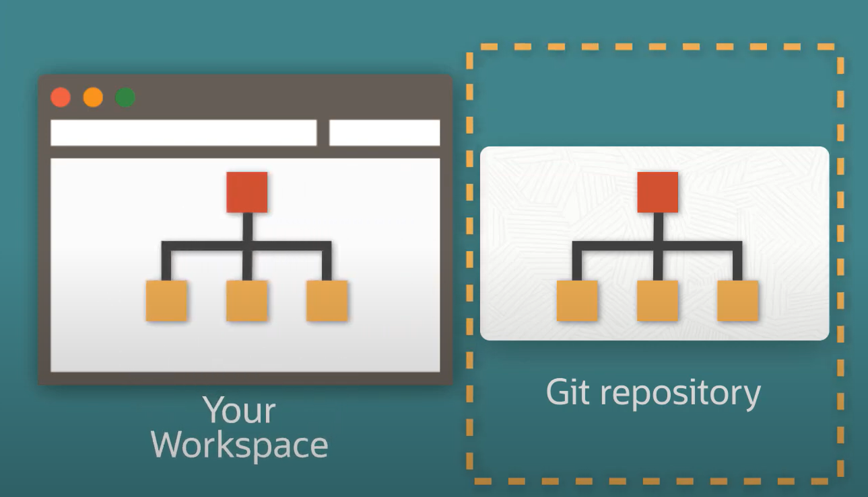
Repository and Working Directory

Slide 12
Savan@Savan MINGW64 /c/Drive/TermWork/Website
$ git init
Initialized empty Git repository in C:/Drive/Study/MCA/DDU/SEM_2/Seminar/Demo_TODO/.git/
Savan@Savan MINGW64 /c/Drive/TermWork/Website
$ touch README.MD
Repository and Working Directory

Slide 13
Repository and Working Directory

Slide 14
Repository and Working Directory

Slide 15
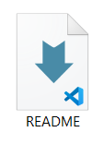
Savan@Savan MINGW64 /c/Drive/TermWork/Website
$ git init
Initialized empty Git repository in C:/Drive/Study/MCA/DDU/SEM_2/Seminar/Demo_TODO/.git/
Savan@Savan MINGW64 /c/Drive/TermWork/Website
$ touch README.MD
Repository and Working Directory

Slide 16
Empty
Savan@Savan MINGW64 /c/Drive/TermWork/Website
$ git init
Initialized empty Git repository in C:/Drive/Study/MCA/DDU/SEM_2/Seminar/Demo_TODO/.git/
Repository and Working Directory
Savan@Savan MINGW64 /c/Drive/TermWork/Website
$ touch README.MD

Slide 17
Git
Git states

Slide 18

Staging area
Empty
Untracked
Stage files
Commit
Remove the file
Untracked

Slide 19
Staging area
Empty
Untracked
Stage files
$ git add README.MD
Commit
Staging area
Remove the file

Slide 20
Empty
Untracked
Staging area
Commit
Stage files
Commit
Remove the file
Staging area

Slide 21
Empty
Untracked
Staging area
Commit
Stage files
$ git commit –m “Initial commit”
Commit
Remove the file
Commit

Slide 22
Untracked
Staging area
Git repository
Stage files
Commit
Commit made

Slide 23
Untracked
Staging area
Git repository
Stage files
Commit
Commit

Slide 24
Untracked
Staging area
Git repository
Stage files
Commit
Commit

Slide 25
Untracked
Staging area
Git repository
Stage files
Commit
Remove the file
Commit
Notes:
Explain staging area

Slide 26
The repository is essentially the .git hidden folder inside the working directory (workspace).
The working directory (workspace) is essentially your project folder.

Slide 27
Git
Add multiple files to Staging area

Slide 28
Git
Add multiple files to Staging area
$ git add README.MD

Slide 29
Add files to Staging area
$ git add README.MD
$ git add index.html
$ git add style.css
.
.
.
$ git add .

Slide 30
Git
Call everyone to the Stage
Everyone come on the stage
$ git add .
$ git add README.MD
$ git add index.html
$ git add style.css
.
.
.

Slide 31
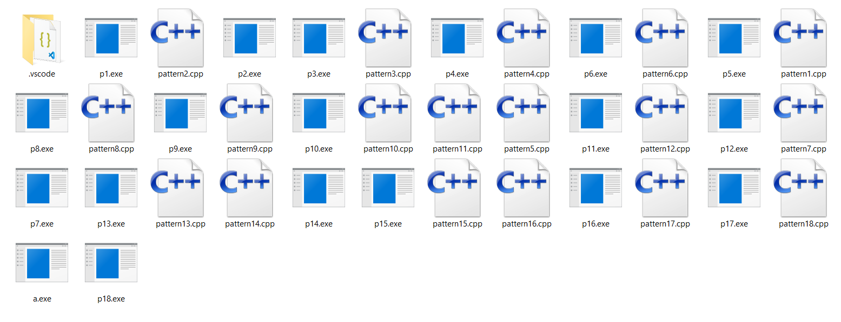
Git
Call everyone to the Stage
Everyone come on the stage
$ git add .
$ git add README.MD
$ git add index.html
$ git add style.css
.
.
.

Slide 32
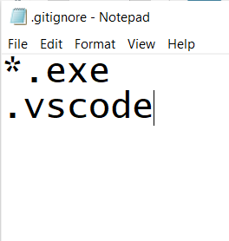
Git
Call everyone to the Stage
Everyone come on the stage
Except these
$ git add .
.gitignore
$ git add README.MD
$ git add index.html
$ git add style.css
.
.
.

Slide 33
Git
Basic Commands
$ git init
$ git add
$ git commit
$ git commit
$ git status
$ git log

